Slide 1
Parkinson’s Disease
Preliminary Literature Review

Slide 2
Remote Gait Type Classification System Using Markerless
2D Video
A markerless approach makes the study more replicable in real-world conditions
For this paper, a novel dataset - GAIT-IT - was created.
21 subjects were involved. 5 types of gait and 2 severity levels were shot.
Side-view videos of the subjects were shot with a green background. Using a green background made it easier to subtract the background and obtain a silhouette.
4 types of videos are provided - silhouette, skeleton silhouette, gait energy images, and skeleton energy images.
To obtain the skeleton from the binary silhouette video, the OpenPose software was used.
Energy images were obtained by superimposing the videos on top of each other.
A second dataset was also for pre-training: INIT dataset
This dataset comprises of binary gait silhouette videos of 10 subjects

Slide 3
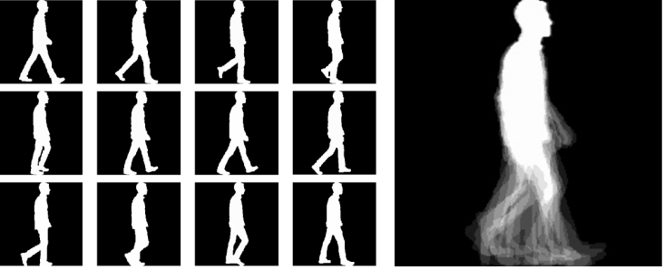
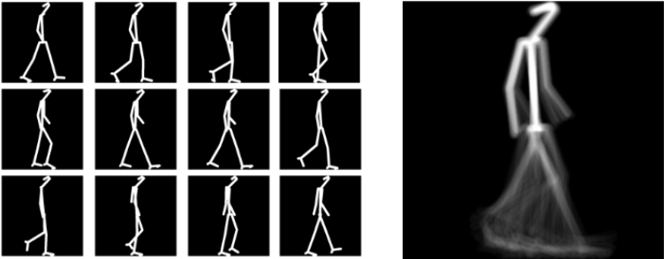
Binary Silhouettes, Gait Energy Image, Skeleton Silhouettes, Skeleton Energy Image (left to right)

Slide 4
A 5-layer CNN is used for the classification of SEIs and GEIs.
Each convolution layer is followed by a batch normalization layer.
The network consists of two dense layers in the end with a dropout layer with a 0.5 value between them.
The learning rate used for training is 1e-3.
A further experiment is conducted with a fine-tuned VGG-19.
The proposed model achieves a very similar accuracy result as the VGG-19 model, while training faster by a factor of 15, and testing faster by a factor of 6.
Later, cross evaluation between GAIT-IT and GAIT-IST datasets was performed.
This resulted in the proposed architectured performing slightly better than the VGG19 architecture.

Slide 5
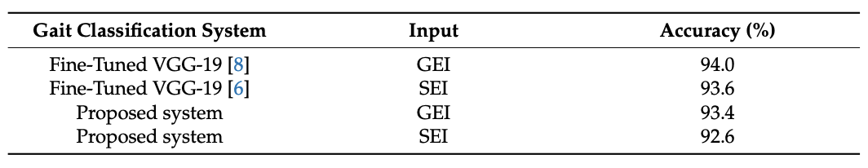
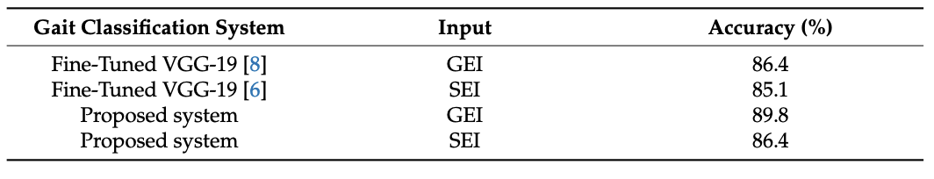
Training and testing on the GAIT-IT dataset
Training on GAIT-IT dataset and testing on GAIT-IST dataset

Slide 6
Pose-Based Gait Analysis for Diagnosis of Parkinson’s Disease
In this paper, videos from everyday situations are used to determine the onset of Parkinson's.
For this research, a new dataset was created.
This dataset consisted of 167 subjects - 93 healthy, 75 with PD.
Most of the videos are taken from sources online such as YouTube.
Markers are applied to the video using AlphaPose. The markers are provided in a json file in the following format: (xi, yi, pi, …), where x and y represent the coordinates of the ith point, and pi represents its probability.
Multiple features from each video such as posture, step, cadence, et cetera, were measured

Slide 7
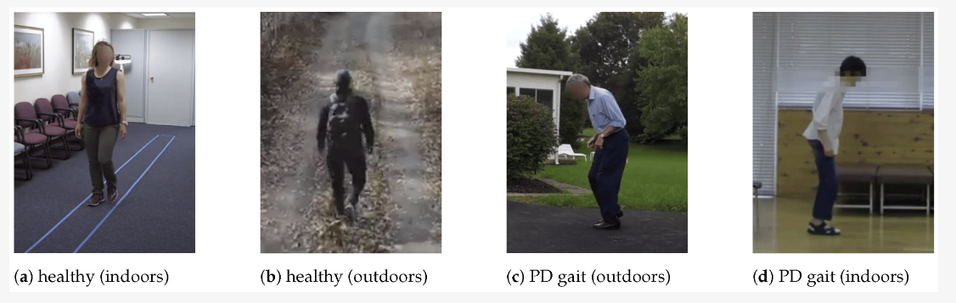
Classes in the dataset

Slide 8
Before the training process, the data was augmented
Each video was flipped and appended to the original video. Then, each video was divided into 6 sequences of 180 frames
A 5-fold cross-validation approach was utilized, whereby, the worst-performing markers were removed iteratively until an optimal result was achieved.
A random forest classifier was used to classify the videos
The best performance was achieved on the side-view videos

Slide 9
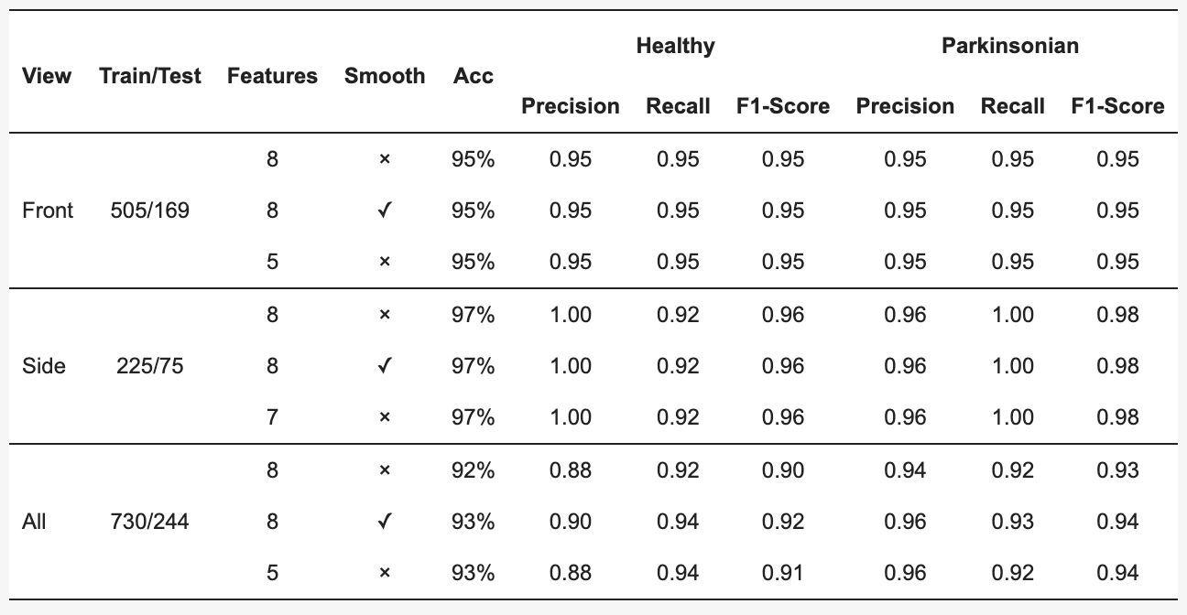
Accuracy and other results divided based on the video type

Slide 10
Pathological Gait Datasets
"Pathological Gait Classification Using Kinect v2 and Gated Recurrent Neural Networks” proposed the said dataset
They used a gated recurrent unit-based classifier and achieved a 93% accuracy in identifying pathological gaits
Using a GRU-based architecture is similar to an LSTM. However, fewer computational resources are used.
This architecture out-performed LSTM, RNNs, and CNNs.
A dataset with 6 different classes and 120 different videos. Overall, the videos are from 10 subjects.
The dataset is similar to the skeleton frames in the first paper (Slide 2)
The keypoints are accessible through the GitHub repository.
The dataset can be requested on: kooksung930@gm.gist.ac.kr

Slide 11
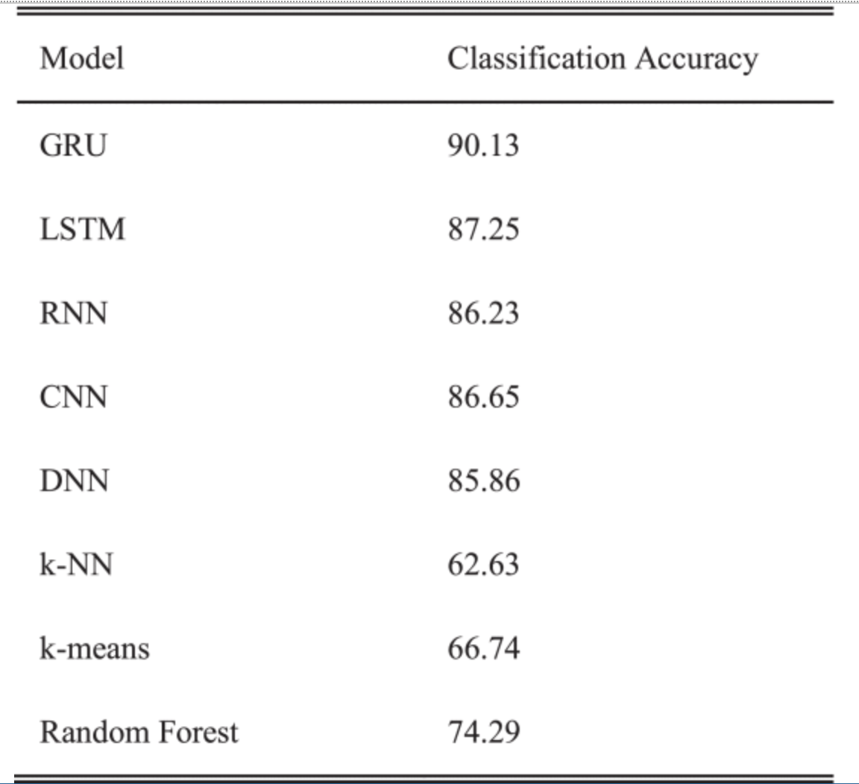
Testing results from different architectures

